Slide 1
Hackathon 2024: TECH TRIBES

Slide 2

Team Name and Members
TECH TRIBES
SOLOMAN VARGHESE
SEMESTER -8
DEPT- Computer Science and Engineering
TECHNICAL INTEREST – Machine Learning
PROJECT – Desktop Companion Robot

Slide 3

TECH TRIBES
VISHNU P R
SEMESTER -8
DEPT- Computer Science and Engineering
TECHNICAL INTEREST –Full Stack Web Devoloper
PROJECT – Automatic Weighing Machine

Slide 4

TECH TRIBES
SREYAS UNNI
SEMESTER -8
DEPT- Computer Science and Engineering
TECHNICAL INTEREST – Python
PROJECT – Gym App using Computer Vision

Slide 5
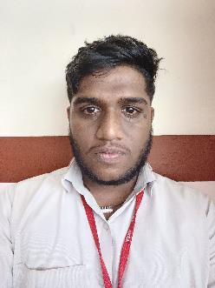
TECH TRIBES
SREENATH M S
SEMESTER -8
DEPT- Computer Science and Engineering
TECHNICAL INTEREST –Data Analytics
PROJECT – Decentralized Charity Portal

Slide 6

TECH TRIBES
KIRAN KRISHNAN
SEMESTER -4
DEPT- Computer Science and Engineering
TECHNICAL INTEREST – Python
PROJECT – Food Prediction using AI

Slide 7
LLM Problem Statement: Why
A chatbot for equity research analysis
We have selected this because there are many people who were try to deposit in mutual funds. So they have to research about mutual funds scheme and the company.
Hence we need a perfect companion for assist each individual for their deposit.

Slide 8
LLM Business Problem: What
In this first user, give the link in the search bar.
Then the AI read the given links.
After that the user can interact with the AI bot to get suitable answers for the questions he got.
AI interact with users with the data available from the links given by user.
So he could safely and easily take shares from equity funds

Slide 9
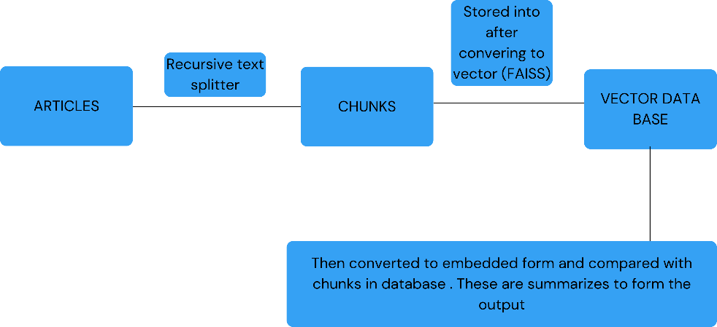
TECHNICAL ARCHITECTURE

Slide 10
Solution Overview: How
Ensuring Accuracy and Reliability of Financial Data:
How: Integrate with reputable financial data APIs for real-time updates and implement rigorous data verification protocols to maintain accuracy.
Understanding Complex Financial Queries:
How: Enhance the chatbot with advanced natural language processing (NLP) techniques focused on financial literacy and employ a feedback loop to refine its understanding and responses over time.
Compliance and Ethical Considerations:
How: Design content with input from legal experts to stay within regulatory guidelines, include clear disclaimers, and, if necessary, facilitate connections to licensed financial advisors for personalized advice.

Slide 11
Economic Logic
Cost gaining
Revenue opportunity
Competitive advantage
Assetiveness gain

Slide 12
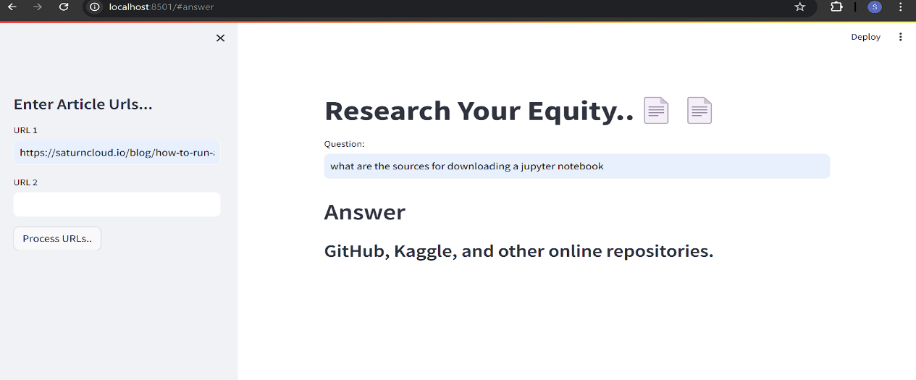
Project Demo

